Slide 1
Estonia, the Digital Republic
Key elements to digitize a society (and how we did it)
Toomas Hendrik Ilves

Slide 2
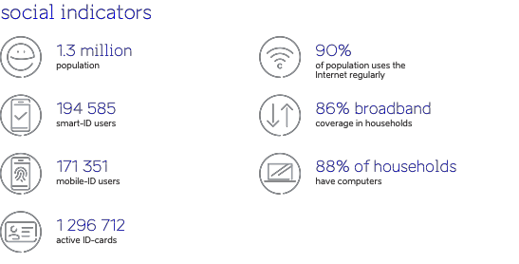

Slide 3
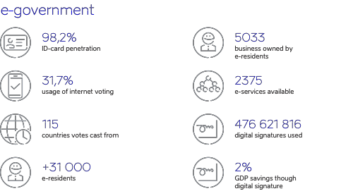

Slide 4
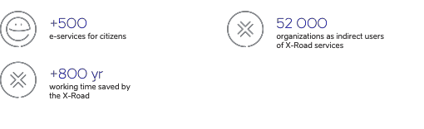

Slide 5
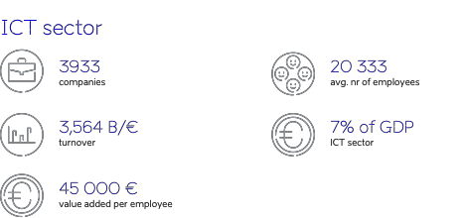

Slide 6
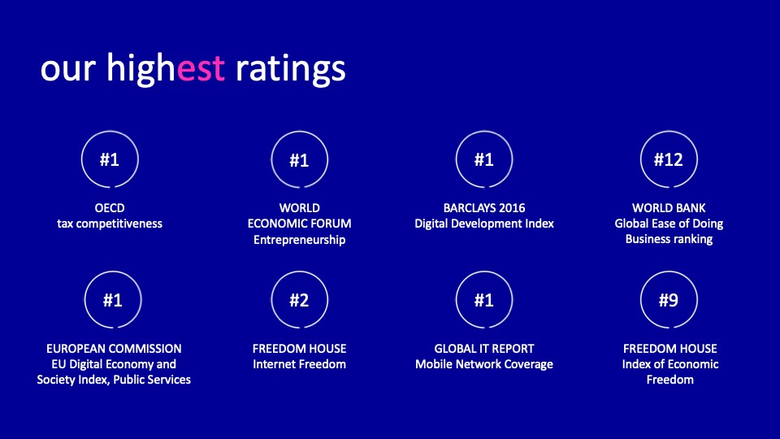

Slide 7
My talk in 5 bullet points
With the cost of computing decreasing at Moore’s law, money is no longer an obstacle to digitization.
It comes down to:
  Political Will, which begets:
    Policy, which begets:
      Legislation and legislative frameworks, which beget:
        Regulation

Slide 8
What you need for effective e-governance in four bullet points
A Strong, Secure, Identity with Legal efficacy with wide use to guarantee:
Digital Services that people and businesses, not just the Ministry of Finance bureaucrats want
A secure architecture for citizen and private sector services, preferably with a distributed exchange layer
You need to guarantee data integrity

Slide 9
The Estonian e-Governance System
Built on existing standards
Open source, non-proprietary software
Strong Private sector participation and investment
Infrastructure set up in 2001
All new services rely on this infrastructure
Thus easy to set up

Slide 10
How and why we got here… our cousins, the Finns
The last full year before WWII Estonia and Finland GDP per capita was
identical
1992, first full year of re-established Estonian independence Estonian GDP per capita was 2 832 USD
Finnish GDP per capita in 1992: 22,337.49 USD

Slide 11

They had the Nokia

Slide 12

Estonia had…

Slide 13
What to do?
Do no reforms, i.e. follow Soviet path?
Become Hong Kong?
Radical economic reforms (privatization, property restitution, elimination of tariffs, own fully-backed currency

Slide 14
Still looked bleak
50 years of shoddy or absent infrastructure it would take decades to build
Reforms take years, even decades to have an effect
Poor population (but well educated)

Slide 15
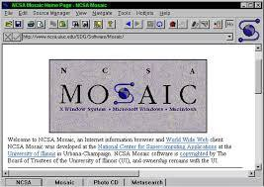
1993! Mosaic. The first Web Browser where the world, rich and poor, competes on a level playing field

Slide 16
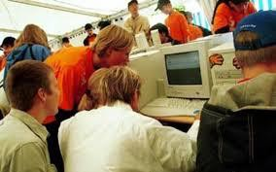
Step 1: get them young Tigerleap: all schools online

Slide 17

Access for everyone

Slide 18
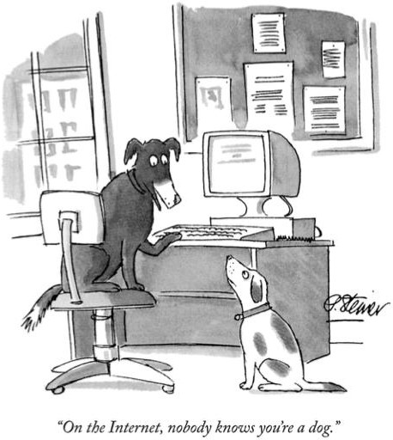
The fundamental issue:

Slide 19
A digital Identity needs
To be secure and unique, i.e. belonging only to you
Legal efficacy (Digital signature law)
Use at least Two Factor Authentication
Use End-to-End Encryption.
Wide-spread if not mandatory distribution (but not mandatory use)

Slide 20
2000 Digital Signature Law
Digital Signature equivalent to physical signature
Underlies all legal digital transactions — contracts, applications, money transfers, prescriptions, tax returns, votes… etc.
Allows Estonia a far more robust and powerful e-governance system than in most places.

Slide 21
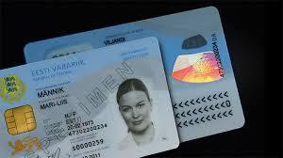
2001 Rollout of Digital Identity card

Slide 22
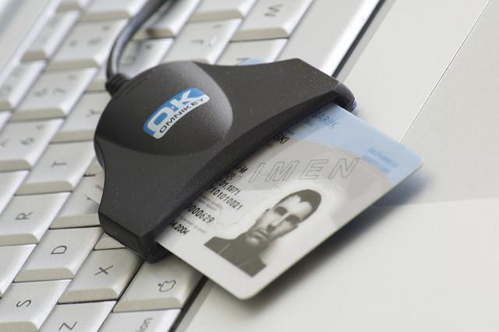

Slide 23
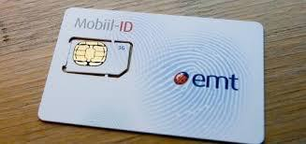

Slide 24
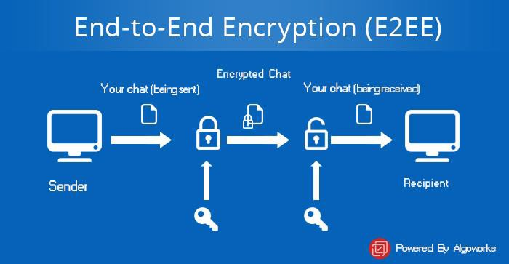
End-to-End Encryption (E2EE)
Based on the chip in the ID or mobile SIM card

Slide 25
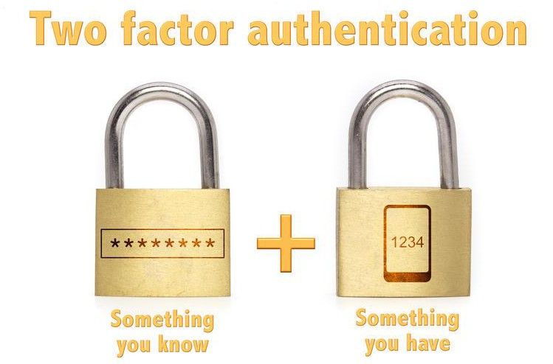
Two-factor authentication (2fa)

Slide 26
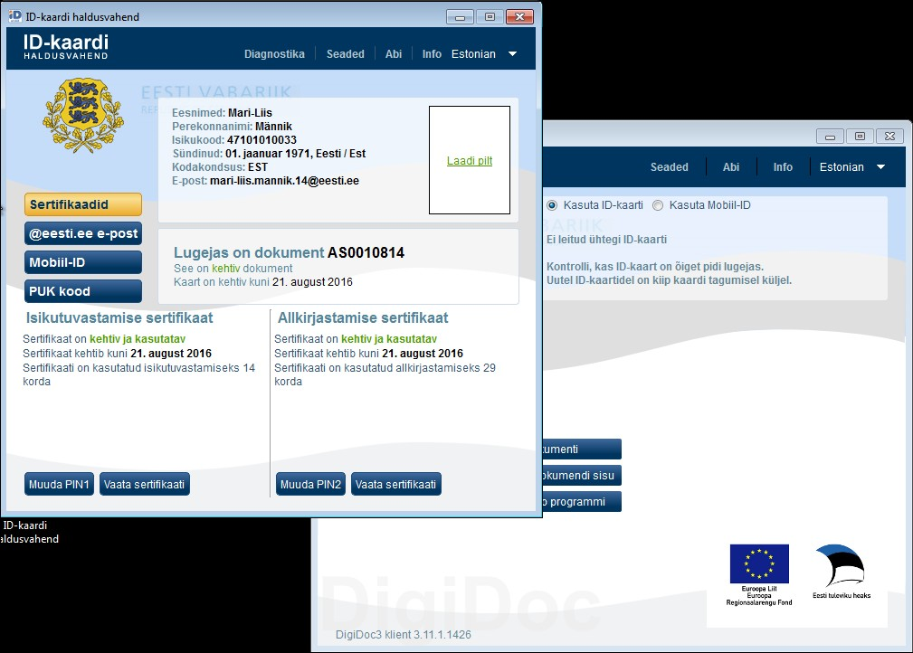

Slide 27
How to access services securely with a secure ID
The Architecture must be secure
Estonia chose a distributed data exchange layer. We call it the X- Road.
No Central Data Base
You can only access data by verifying yourself with 2FA

Slide 28
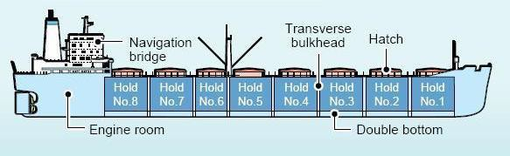
Think of a modern ship with separate holds

Slide 29
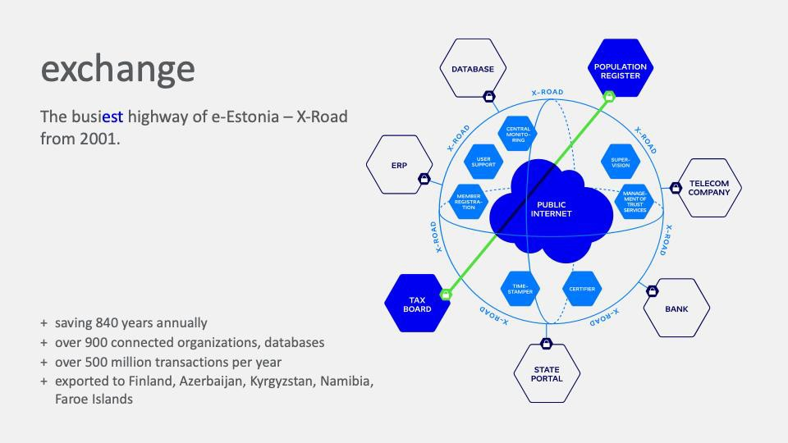
X-Road: A distributed Data Exchange Layer

Slide 30



Slide 31
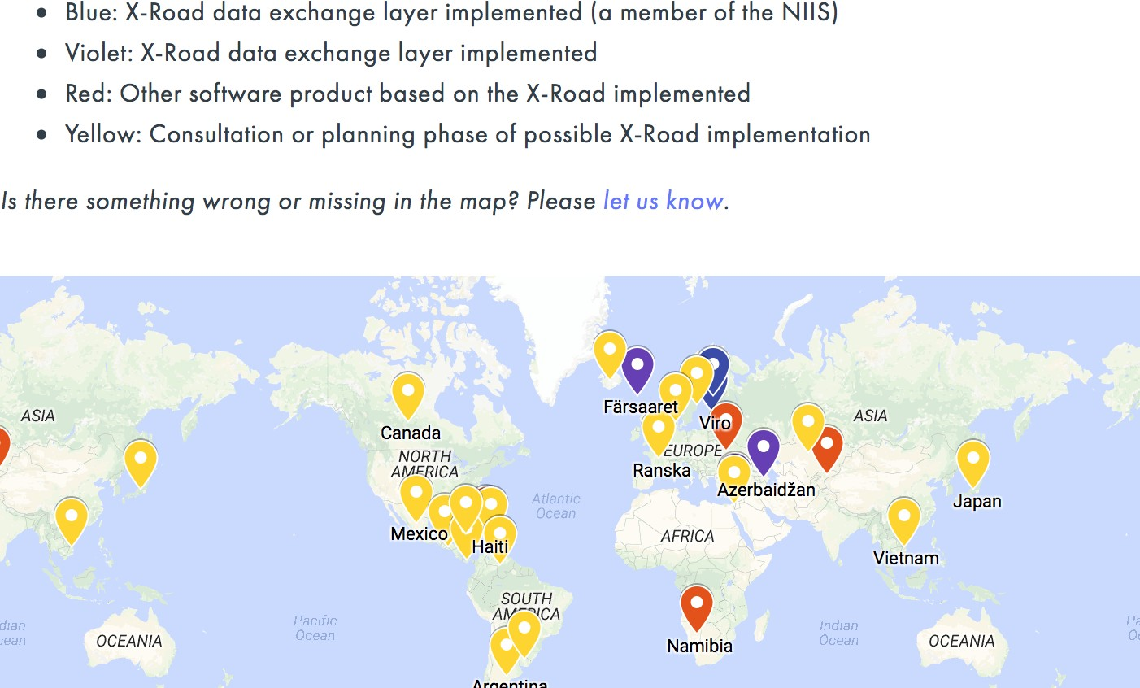
Type to enter a caption.

Slide 32
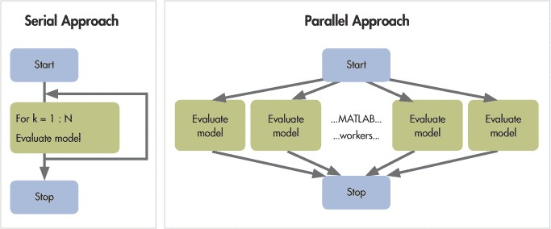
A Revolution in bureaucracy: Sequential vs Parallel processing

Slide 33
Which leads to… the Once Only rule
You never have to add information the system already has
No addresses, phone numbers or any other information already existing
Your digital identity allows you to access anything you are entitled to access.

Slide 34
Privacy vs. Integrity
Privacy is to ensure others do not see or copy my data
Integrity is to ensure your data is not changed by others

Slide 35
Some subsequent developments
E-voting
E-prescriptions
E-residency
Data embassies

Slide 36
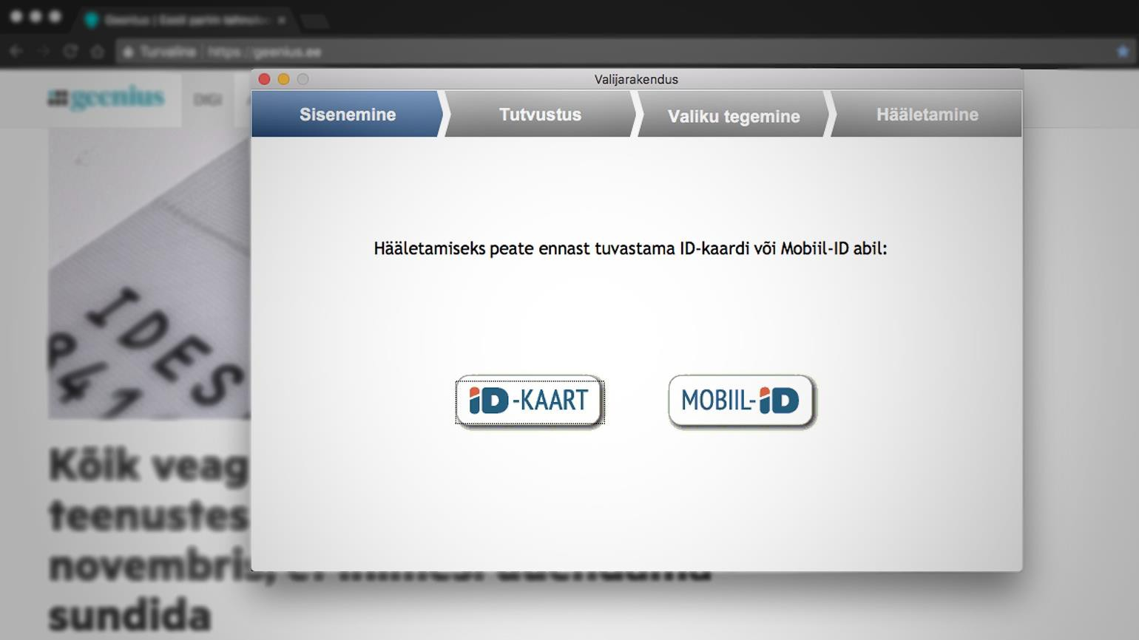

Slide 37
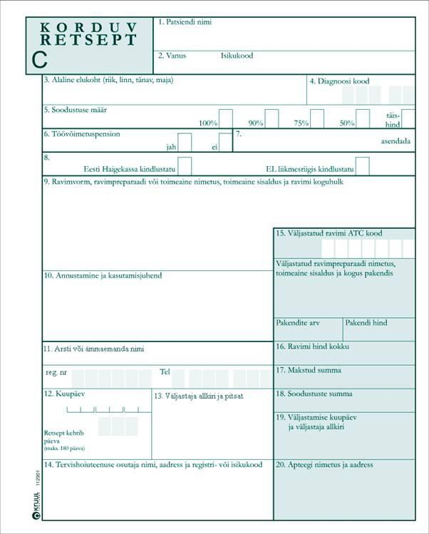

From this…

Slide 38
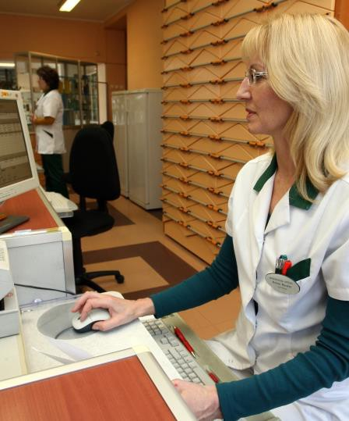
To This…

Slide 39
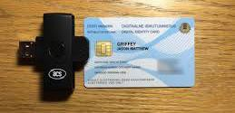

Slide 40
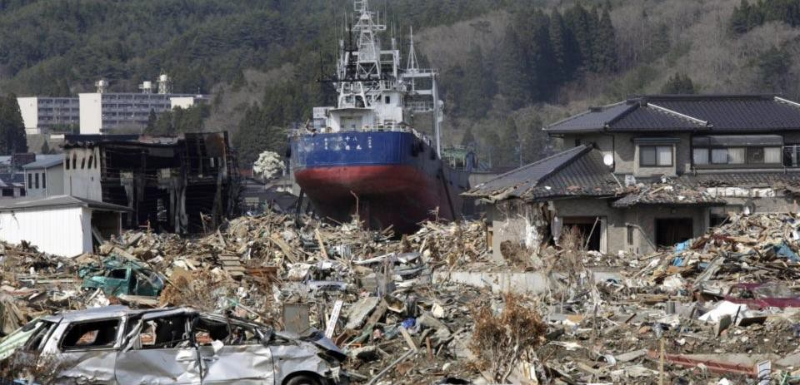
Data Embassies

Slide 41

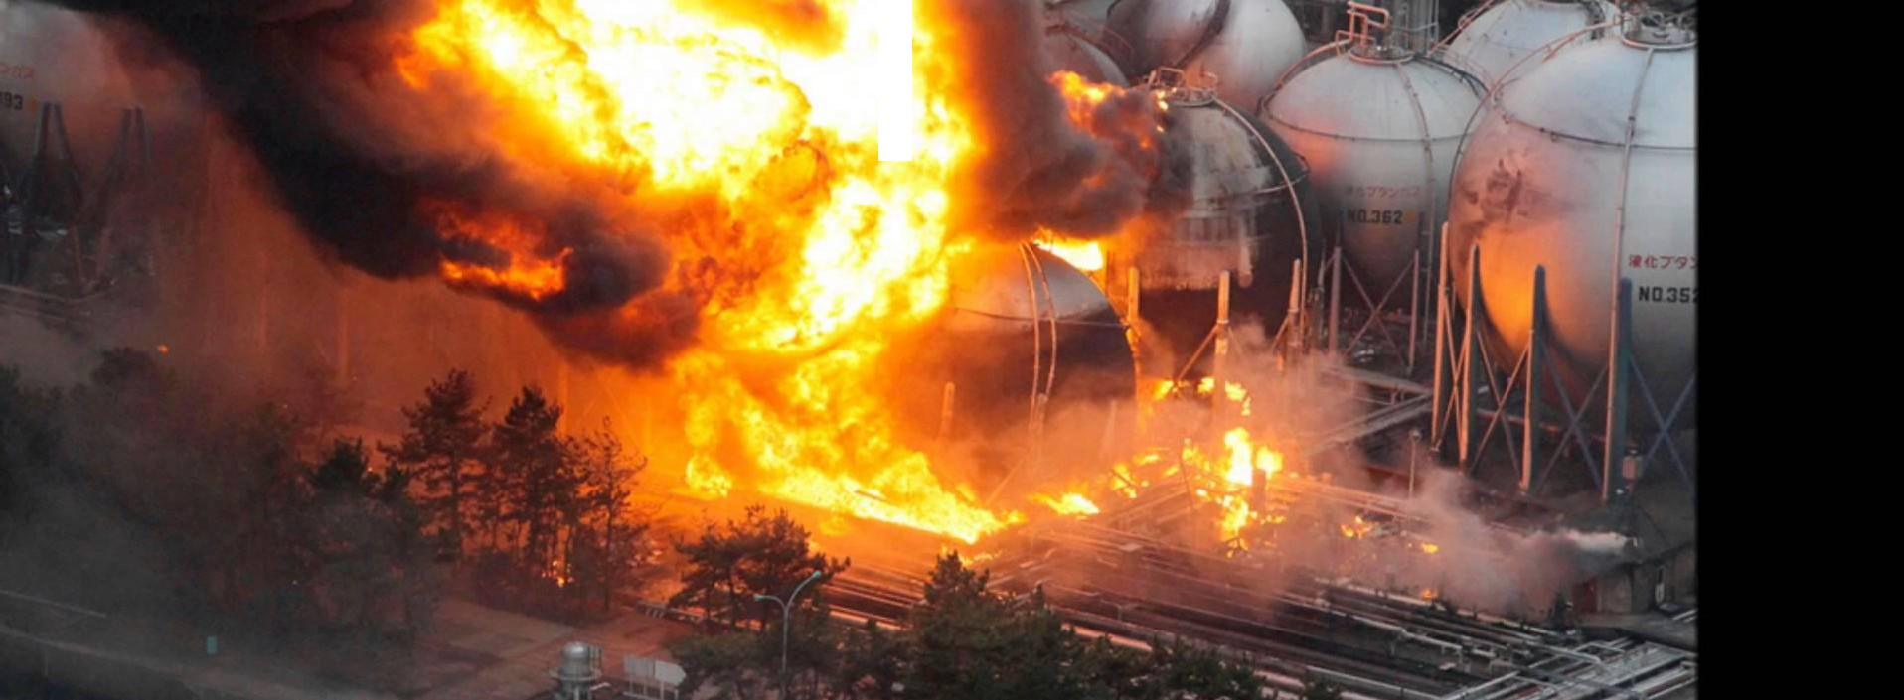
'.

Slide 42
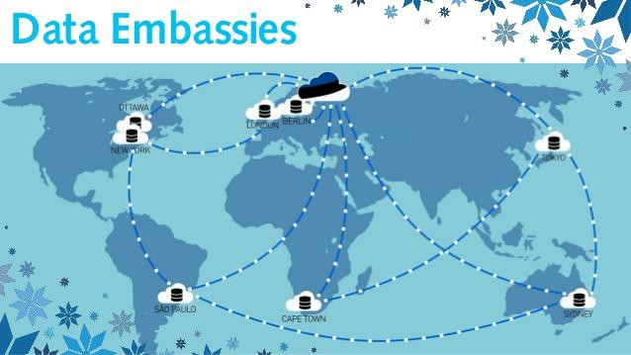

Slide 43
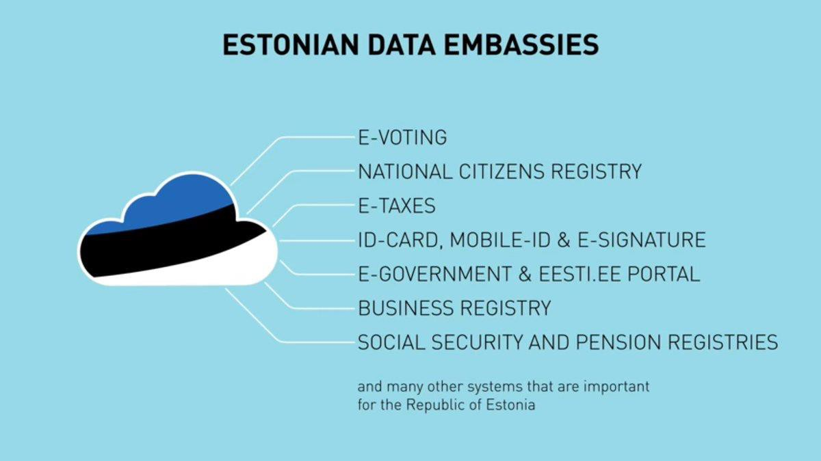

Slide 44
Gracías Thank you

