Slide 1
MINISTERIO DE CIENCIA, TECNOLOGÍA Y TELECOMUNICACIONES
Costa Rica, November 10th 2020
II Workshop on Governance of Clinical Trials, recommendation of the OECD
Recommendation of the Council on the Governance of Clinical Trials
(OECD/LEGAL/0397)
jacques.demotes@ecrin.org
www.ecrin.org
Jacques Demotes
10 November 2020

Slide 2
Need for international cooperation in clinical research
access to patients : faster results, statistical power
access to medical expertise
unlock scientific potential, especially on rare diseases, personalized medicine… and COVID-19 outbreak
share best evaluation practice
raise methodological standards
avoid duplication of clinical research
share costs, share common tools and procedures
better generalizability
foster broad implementation of research outcomes
2

Slide 3
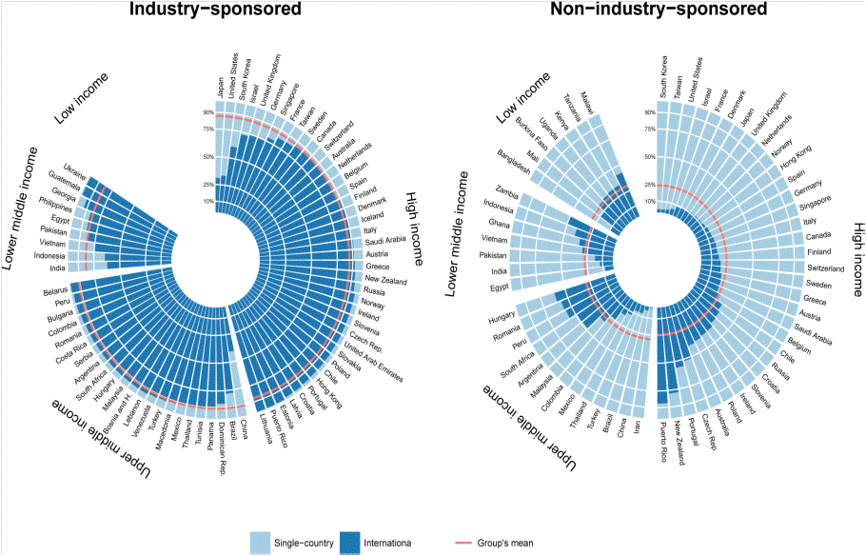
Multinational clinical trials : industry vs. academic trials
3
  Atal et al. “Differential Globalization of Industry- and Non-Industry Sponsored Clinical Trials” PLoS One. 2015 Dec 14;10(12)

Slide 4
Obstacles: national differences in
infrastructure, interoperable tools and procedures
data standards
regulation (medicines, medical devices, nutrition, other)
data protection regulations
ethical review
Insurance / indemnification
contracts
cross-border management of IMP and biosamples
funding opportunities, cost models
language
health systems
4

Slide 5

  http://www.oecd.org/sti/sci-tech/oecd-recommendation-governance-of-clinical-trials.pdf

Slide 6
OECD Recommendation on the Governance of Clinical Trials :
1 - risk-based approach
2 - regulatory harmonisation
  Trial oversight dependent on trial objective ?
  ex IND / non-IND trials
  Trial oversight similar whatever its objective ?
  ex 2001/20/EC Directive
  same level of participant protection
  excessive burden for low-risk trials
  Trial oversight and governance adapted to the risk
  reduce unnecessary burden for lower-risk trials
  same level of participant protection, whatever trial objective
  contributes to global harmonisation of regulatory framework
  Non-commercial, also commercial trials

Slide 7
Objective 1 : adopt a risk-based approach
  1 - How to assess risk in clinical trials ?
  Risk stratification according to marketing authorization status
  Continuous, trial specific risk assessment for other risk determinants
  2 - Risk adapted principles for clinical trial oversight and governance
    Regulatory / ethical oversight
    Monitoring, insurance, etc

Slide 8
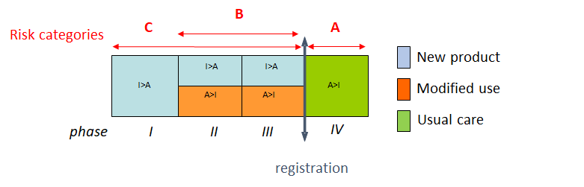
Risk stratification according to marketing authorization status
A - Comparative effectiveness trials (usual care)
  compare efficacy and safety of authorised products
  phase IV
B - Repurposing trials (modified use)
  exploring new indications for authorised products
  phase II - III
C - Development of innovative health products
  registration trials - phase I – II – III
8

Slide 9
Principles for risk assessment: stratified and trial-specific approaches
I - Risk to participant rights:
  I.1 patient information
  I.2 personal data protection
II - Risk to participant integrity and safety:
  II.1 safety of the treatment intervention
    New product
    Modified use
    Usual care
  II.2 risk, burden and intrusion of invasive procedures
  II.3 vulnerability of patient population
III – Risk to data quality, results and public health:
  III.1 data quality
  III.2 credibility of results
  III.3 impact on healthcare practice and public health

Slide 10
Impact of risk categorization on the oversight and management of clinical trials
Authorization by regulatory authority
    optional for ‚usual care‘
Indemnification / insurance
  coverage by public health system for ‚usual care‘ and established off-label use
Cost of IMP
  borne by healthcare payer in ‚usual care‘ and established off-label use
  Cost-effective tracing and labelling
Documents
  Investigator brochure replaced by summary of product characteristics, no IMP dossier for low risk trials
10

Slide 11
Impact of trial-specific risk assessment : risk adaptation and risk mitigation
Approval by regulatory authority
    Adapt the content of application dossier
Safety reporting
    Protocol may contain specific provisions on the reporting of foreseeable adverse event
Indemnification / insurance
  Same risk assessment principles should be used to determine risk / participant integrity and safety
IMP management
  Labeling adapted to protocol (blinding, administration etc)
Quality management
  Monitoring plan adapted to protocol and statistical plan
11

Slide 12
Stratification and oversight for clinical trials on medicinal products in various countries / regions
Marketing authorisation status of the medicinal products | Non-authorised medicine | Authorised medicine, treatment regimen outside marketing authorization |  | Authorised medicine tested within marketing authorisation
 |  | not supported by established medical practice | supported by established medical practice
USA | IND trials supervision by FDA approval by IRB |  |  | non IND studies approval by IRB
Japan | chiken trials supervision by PMDA approval by IRB |  |  | non-chiken studies approval by IRB
Australia | exemption scheme approval by CA (TGA) approval by EC notification scheme approval by EC (EC decides if TGA should be involved, based on trial protocol)
2001/20/EC Directive | approval by CA approval by EC
UK / 2001/20/EC Directive | approval by CA (MHRA) approval by EC | approval by CA (MHRA) approval by EC |  | notification to CA (MHRA) approval by EC
Draft EU Regulation 2012 | coordinated approval by oversight bodies |  | low intervention trials coordinated approval by oversight bodies
OECD Recommendation | approval by CA/regulatory authority approval by EC/IRB | approval by CA/regulatory authority approval by EC/IRB |  | approval by EC/IRB (notification to, or authorisation by CA is an option)
 | IND: investigational new drug marketing EC: ethics committee IRB: institutional review board CA: competent authority |  |  | authorisation
Objective 2 :
regulatory harmonization

Slide 13

OECD Council Recommendation on the
Governance of Clinical Trials
Adopted by OECD Council December 2012
A policy instrument defining a framework for better oversight over clinical trials
Recommends Members to adapt their national reguations to a risk-based approach
Invites non-Members to adhere to the recommendation

Slide 14
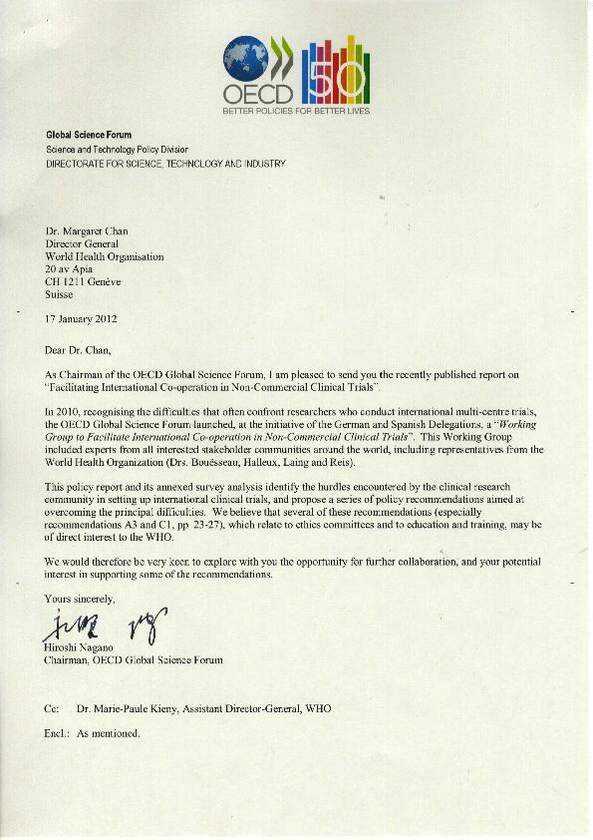
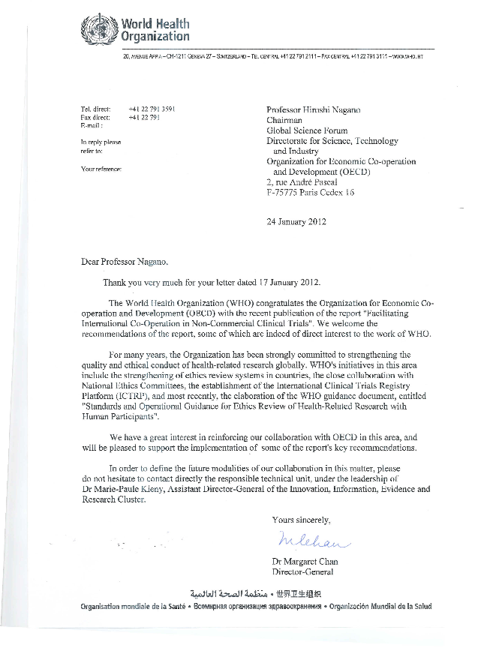
Correspondence between OECD and WHO (2012)

Slide 15

  Clinical Research Initiative for Global Health
  6 projects
    Infrastructure and funding
    Global core competencies
    Research ethics
    Patient involvement
    Comparative effectiveness research
    Data management and sharing
    > 40 Members / Observers
    Secretariat NIH + ECRIN
    OECD and WHO partners
www.crigh.org
Nature 545:289 (2017)
15

Slide 16
Follow-up process
2016 : CRIGH presented at OECD-GSF plenary meeting, October, Paris
2019 : survey and first assessment by OECD-GSF of the implementation of the OECD Council Recommendation on the Governance of Clinical Trials

